Slide 1


How does ChatGPT work?

Slide 2
Some clarifications
Conceptual questions vs.engineering questions
Human-engineered features vs. machine learning

Slide 3
Conceptual Questions
vs.
Engineering Questions

Slide 4
Skip gram
Conceptual question:
What determines the meaning of a word?

Slide 5
Skip gram
Conceptual question:
What determines the meaning of a word?
The distributional hypothesis:
words that are surrounded by similar words have similar meanings

Slide 6
Skip gram
Sentence 1: I have to make sure that the cat gets fed.
Sentence 2: I forgot to make sure that the dog gets fed.

Slide 7
Skip gram
Engineering question:
Why the hidden layer has 300 neurons, not 200, not 500?

Slide 8
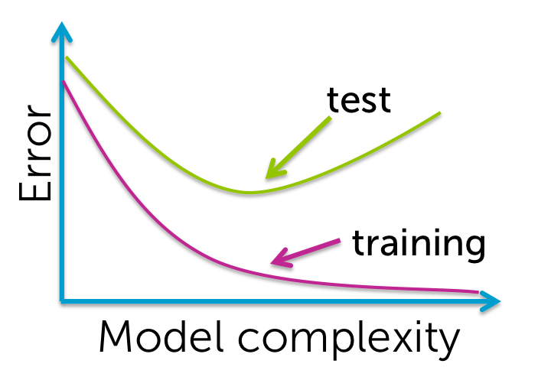
Skip gram

Slide 9
Skip gram

Slide 10
Skip gram
Softmax
o_{n1}
P₁
h_{n1}
o_{n2}
P₂
h_{n2}
x
sum up to 1
o_{n3}
P₃
h_{n3}
o_{n4}
… …
P₄
… …
… …

Slide 11
Human-engineered features
vs.
machine learning

Slide 12


# of bedrooms
# of bathrooms
Age
… … …
… … …
neuron
or
Features

Slide 13
Skip gram
Softmax
o_{n1}
P₁
h_{n1}
o_{n2}
P₂
h_{n2}
x
sum up to 1
o_{n3}
P₃
h_{n3}
o_{n4}
… …
P₄
… …
… …

Slide 14
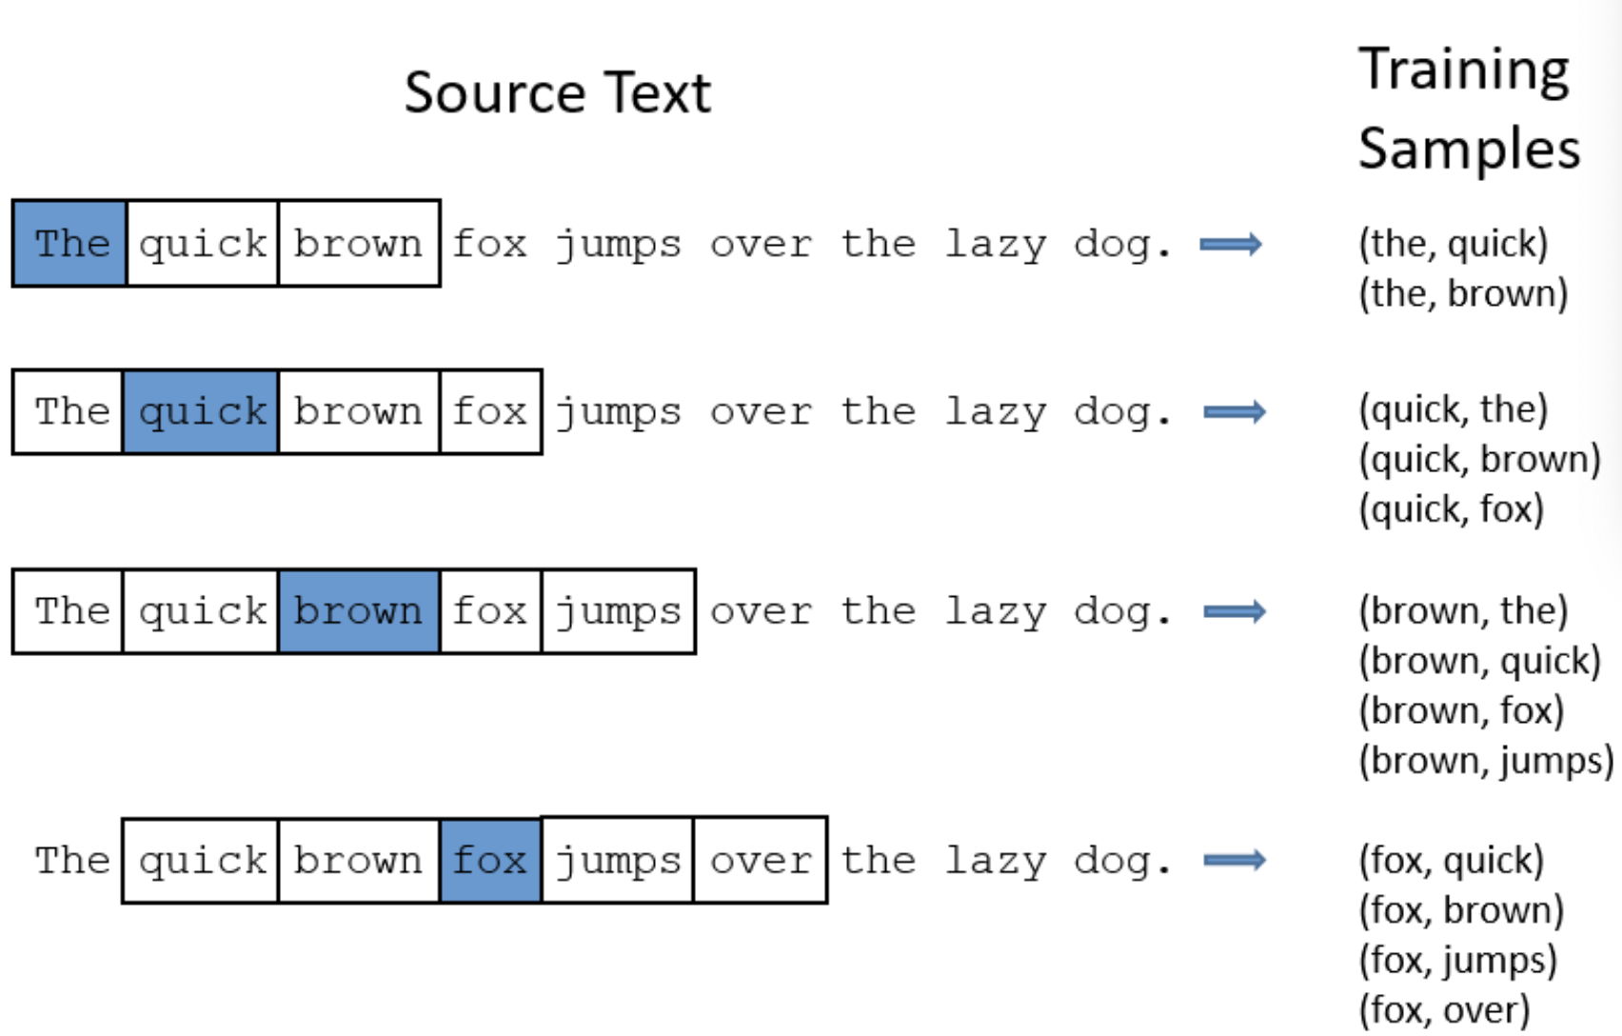
Skip gram

Slide 15
Any questions?

Slide 16
A brief review

Slide 17
ChatGPT
GPT: generative pre-trained transformer

Slide 18
ChatGPT
Transformer
a multi-layer neural network that relies on the parallel multi-head attention mechanism.

Slide 19
Last two sessions
Part 1: multi-layer neural network

Slide 20
From today
Part 2: multi-head attention mechanism

Slide 21
For today
A single self-attention head

Slide 22
Part 2
Learning objectives
Concepts
Understand the temporal dimension of language
Understand some basic concepts in attention
query, key, value, self-attention
Understand a head as a representation of a certain relationship between words
Computation
Understand the power of matrix multiplication for parallel computation

Slide 23
Roadmap
The temporal dimension of language
A single self-attention head

Slide 24
The main task of LM
Given a sequence of words, what is the most likely word that follows the sequence?
The quick brown fox jumps over the lazy dog.

Slide 25
The main task of LM
Given a sequence of words, what is the most likely word that follows the sequence?
w₁w₂w₃w₄ w₅

Slide 26
Temporal dimension
The main task of LM
Given a sequence of words, what is the most likely word that follows the sequence?
w₁w₂w₃w₄ w₅

Slide 27
Temporal dimension
Assumption
Every word in the sequence plays a role in determining what word follows this sequence.
w₁w₂w₃w₄ w₅

Slide 28
Temporal dimension
Assumption
In a word sequence, every word is influenced by the past words and itself, but never by the future words.

Slide 29

Temporal dimension

Slide 30
Temporal dimension

Slide 31
Attention
w₁w₂w₃w₄ w₅

Slide 32
Attention
Damian had a secret child, a girl, and had written in his will that his belongings will belong to _____

Slide 33
Interim summary
Language has a temporal dimension.
When making predictions about future words, we need to pay more attention to certain words in the given sequence.

Slide 34
The task of ChatGPT
Given a sequence of words, generate the next word and continue this process.

Slide 35
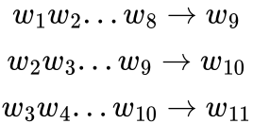
The task of ChatGPT
Context length:8
We are using the past words to predict the future words.

Slide 36
The question becomes:
How do we encode the relationship between the words in a given sequence?

Slide 37

Recall that…
A word is represented by a feature vector

Slide 38
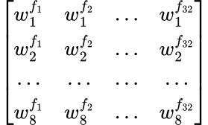
If we have a word sequence of len 8

Slide 39
How do we encode the relationship between the words in a given sequence?
We use attention heads!

Slide 40
Self-attention head
For each word token
query
head
key
value

Slide 41
Self-attention head
For each word token
query
What is the word looking for?
head
key
What information does the word contain?

Slide 42
Self-attention head
HEAD
q
x
…
k
…

Slide 43
Head size
HEAD
# neurons
= head size
q
x
…
# neurons
= head size
k
…

Slide 44
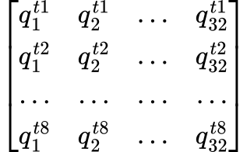
Query
t1
t2
…
t8
Word sequence
Query matrix

Slide 45
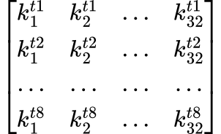
Key
t1
t2
…
t8
Word sequence
Key matrix

Slide 46
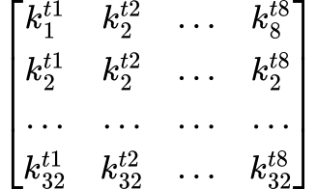
Key^{T}
t1
t2
…
t8
Word sequence
Key matrix

Slide 47
Query · Key^{T}
k^{t1}
k^{t2}
…
k^{t8}
q^{t1}
q^{t2}
…
q^{t8}
Query matrix
Key matrix

Slide 48
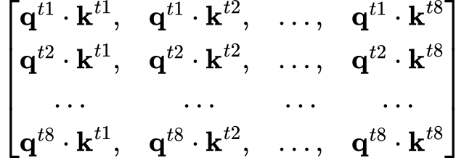
Attention score

Slide 49
But, what about the temporal dimension of language?

Slide 50
Attention score

Slide 51
Attention score

Slide 52
Attention score
-inf

Slide 53
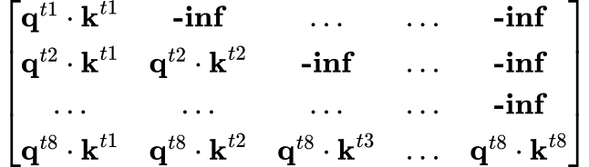
Attention score

Slide 54
Attention scores to weights
softmax
softmax
softmax
softmax

Slide 55
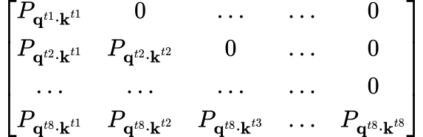
Attention scores to weights
sum up to 1
sum up to 1
sum up to 1
sum up to 1

Slide 56
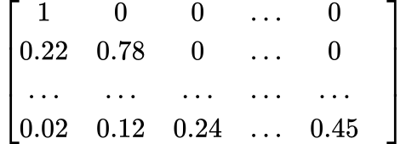
Attention scores to weights
sum up to 1
sum up to 1
sum up to 1
sum up to 1
weight matrix

Slide 57
A visual of what we have learned so far
HEAD
q
…
x
k
…

Slide 58
A visual of what we have learned so far
HEAD
q
…
x
k^{T}
…

Slide 59
A visual of what we have learned so far
HEAD
q
…
x
·
k^{T}
…

Slide 60
A visual of what we have learned so far
HEAD
-inf mask
q
…
x
·
k^{T}
…

Slide 61
A visual of what we have learned so far
HEAD
-inf mask
q
…
x
·
Softmax to each row
k^{T}
…

Slide 62
A visual of what we have learned so far
HEAD
-inf mask
q
…
x
·
Softmax
to each row
w
k^{T}
…

Slide 63
Self-attention head
For each word token
query
head
key
value

Slide 64
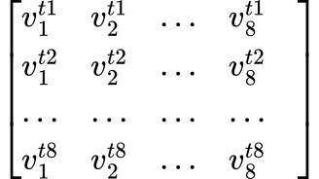
Value matrix

Slide 65
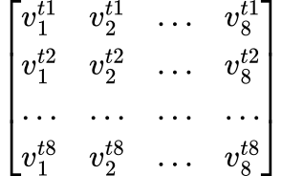
weight · value

Slide 66
weight · value

Slide 67
weight · value

Slide 68
A visual of what we have learned so far
HEAD
-inf mask
q
Softmax
to each row
…
·
w
k^{T}
x
…
v
…

Slide 69
A visual of what we have learned so far
HEAD
-inf mask
q
Softmax
to each row
…
·
w
k^{T}
x
·
…
v
…

Slide 70
References
Jurafsky, Daniel, and James H. Martin. (2023). Speech and language processing: An introduction to natural language processing, computational linguistics, and speech recognition.
Karpathy, Andrej. (2023), GitHub repository, https://github.com/karpathy/nanoGPT
Karpathy Andrej. (2023). Let's build GPT: from scratch, in code, spelled out. [Andrej Karpathy]. YouTube. Retrieved September 5, 2023 from https://www.youtube.com/watch?v=kCc8FmEb1nY
Vaswani, Ashish et al. (2017). Attention is all you need. In Advances in Neural Information Processing Systems. 5998–6008.

